Slide 1


BIG DATA ANALYSIS
TA class II
TA : Lee Chi-Hsuan

Slide 2
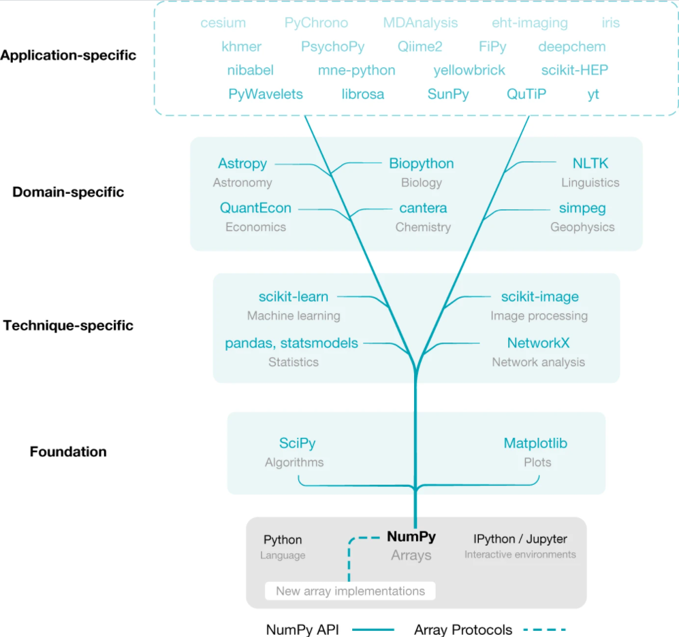
numpy

Slide 3
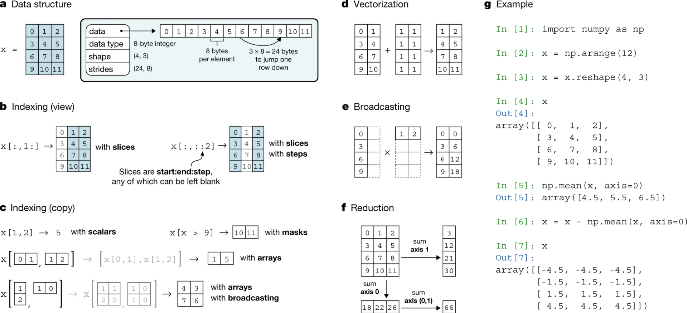

Slide 4
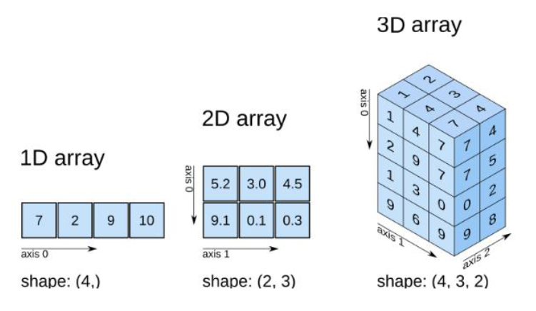
key features :
．ndim
．shape
．dtype

Slide 5
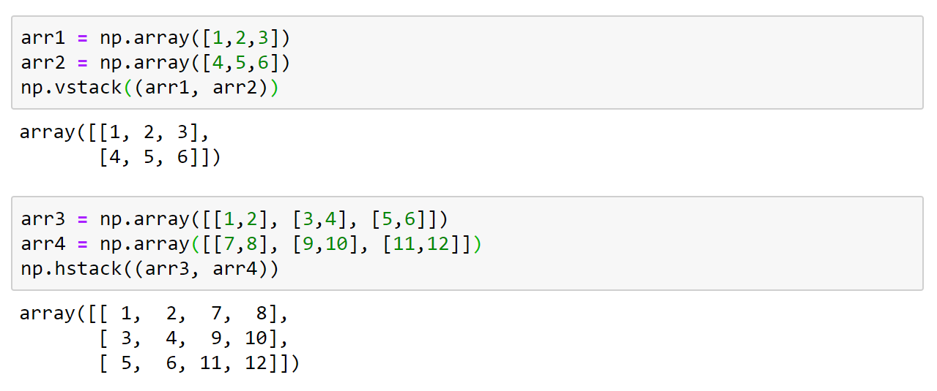
．Some important concepts…
vstack vs. hstack

Slide 6
[ 1, 2, 3 ]
vertical
stack
[ 4, 5, 6 ]

Slide 7
[1, 2]
[7, 8]
horizontal
stack
[3, 4]
[9, 10]
[11, 12]
[5, 6]

Slide 8
axis = 1
[1, 2, 3, 4, 5]
axis = 0
[2, 2, 3, 4, 5]
[3, 2, 3, 4, 5]

Slide 9
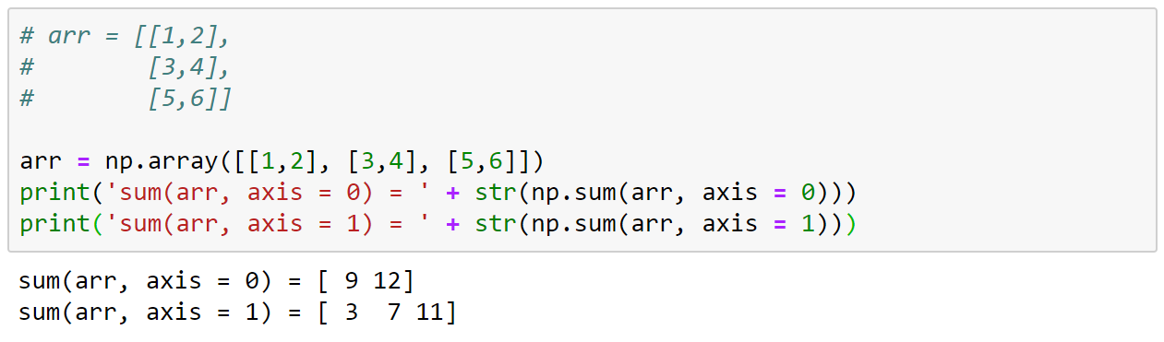

Slide 10
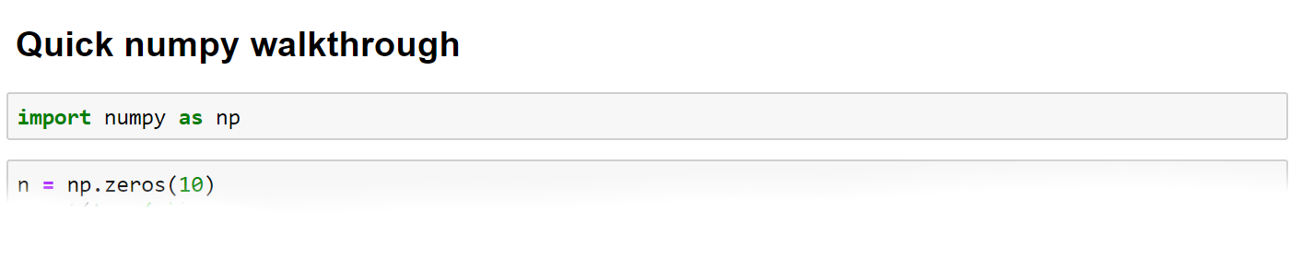
Let’s have a quick walkthrough

Slide 11
Pandas
．a library with fantastic set of tools
for data analysis
．load / prepare / manipulate / ... models
．join / merge / reshape / ... Date

Slide 12
．core structure －Dataframe
．Dealing with header and index
might be tricky sometimes…

Slide 13
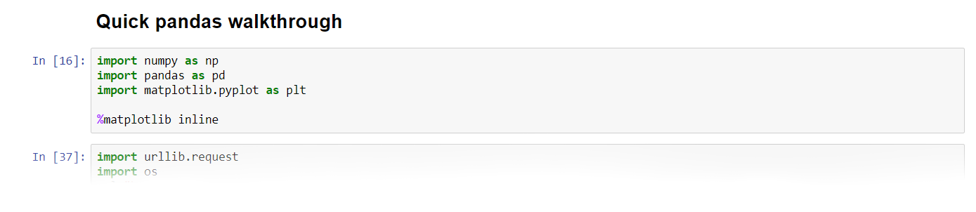
Let’s have a quick walkthrough

Slide 14
Scikit-learn
．machine learning library
．Simple and efficient tools for
predictive data analysis
．Built on NumPy, SciPy, and matplotlib

Slide 15
．Six facets of sklearn :
．Classification
．Regression
．Clustering
．Dimensionality reduction
．Model selection
．Preprocessing

Slide 16
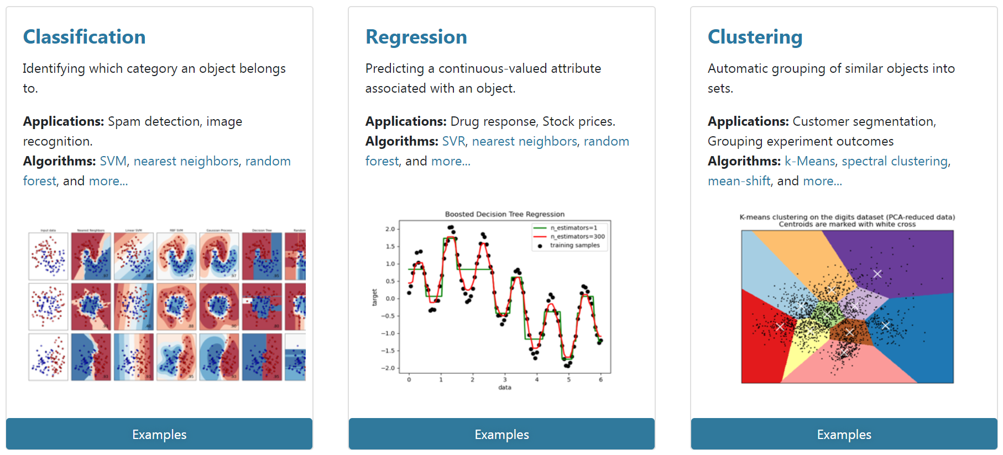
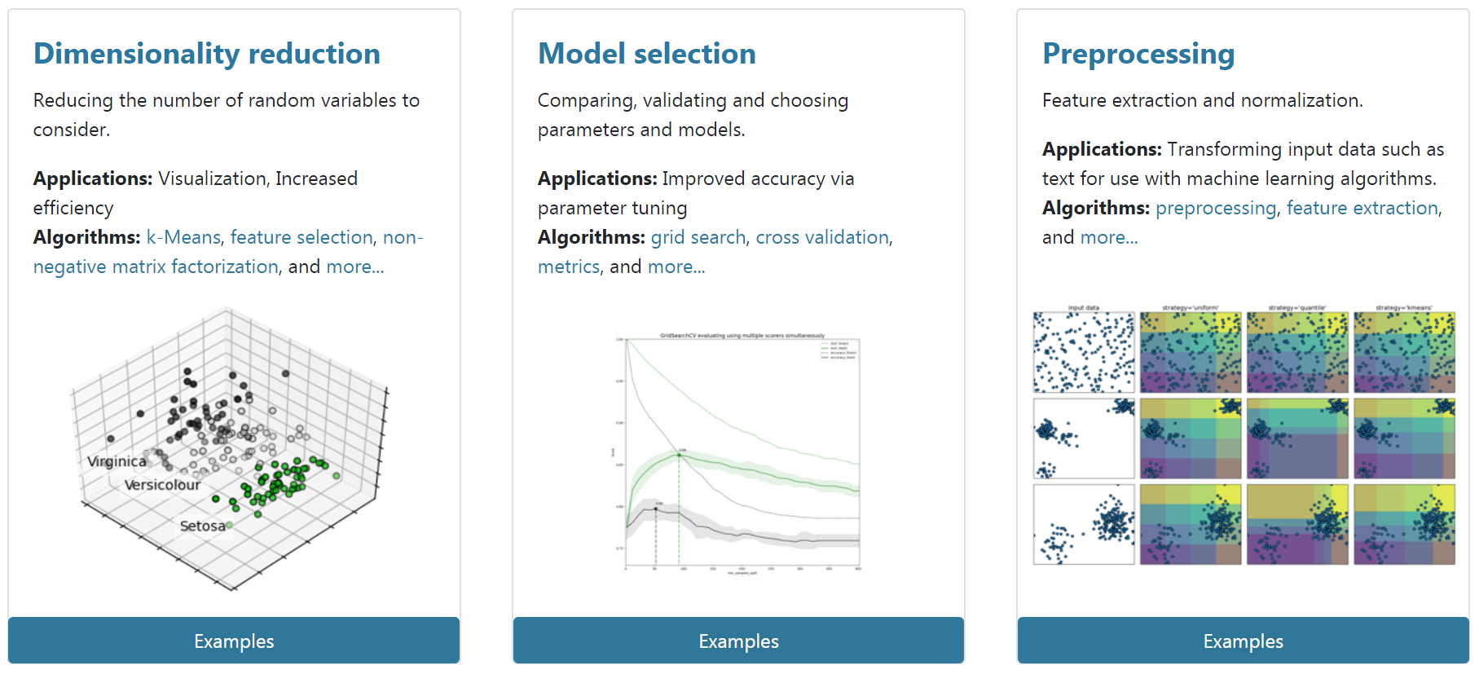

Slide 17
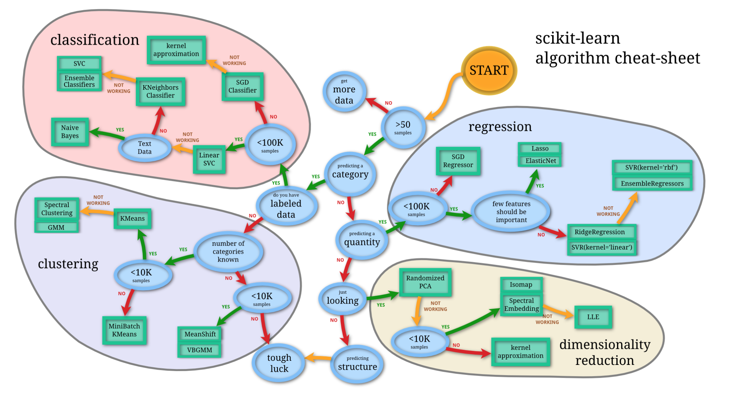

Slide 18
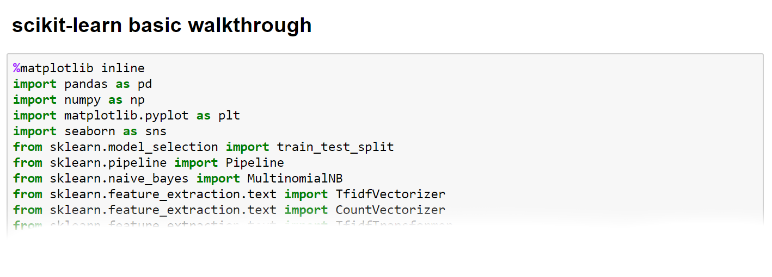
Let’s have a quick walkthrough

